Slide 1

Remote Device Control and Monitor System for the LHD’s D-D Experiments
Nakanishi H. and NIFS ICS team
for
10th IAEA Technical Meeting on Control, Data Acquisition, and Remote Participation for Fusion Research

Slide 2
Background
LHD plans to start D-D experiments in late 2016 FY.
  After D-D exp. started, maintenance works in torus room will be highly restricted.
LHD data acquisition (DAQ) system uses 110 distributed nodes.
  Every DAQ node can be monitored and controlled separately or wholly through the central DAQ manager system in real time.
All the instruments must be remotely managed.
  However, D-D neutrons may cause the electronics non-responding,
  i.e. single event effects (SEEs).
  Software-based remote controls are ineffective for non-responding electronics.
  Remote power recycle will be necessary to reset hardware, in addition to the detailed real-time process monitoring and control.
Integrated remote control & monitor system will be necessary on both software and hardware levels.

Slide 3
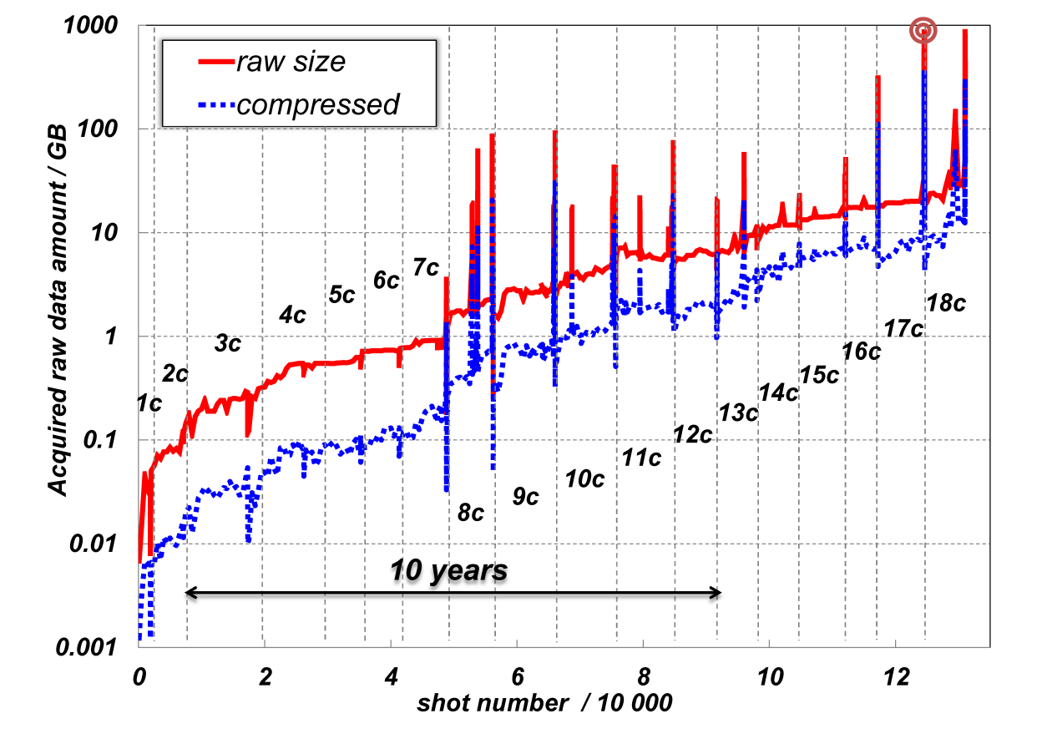
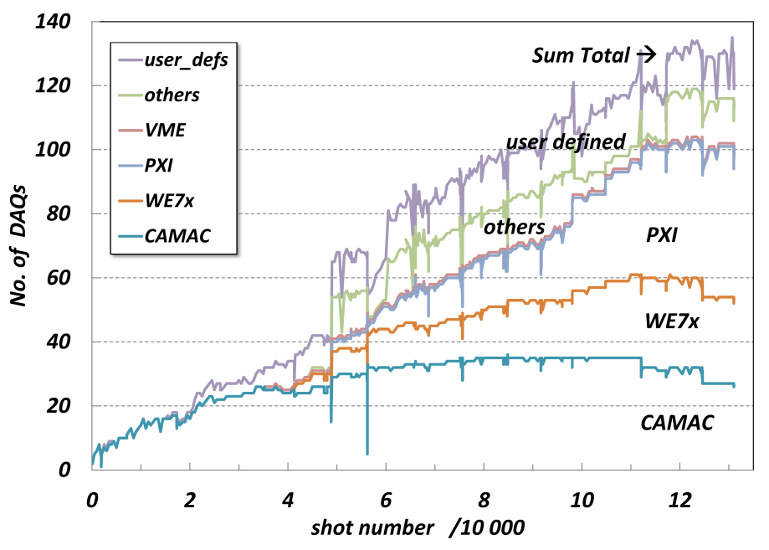
Present status in LHD data growth
No. of DAQs goes up to ~110 in 2014–2015.
Raw data amount still keeps growing:
  > 30 GB/pulse, 892 GB/40 min. long pulse (2014)
  which is reaching the ITER region, 1 TB/pulse ?
892 GB

Slide 4
Remote control tiers
Control tiers for LHD plasma diagnostics consist of:
  PLC network for interlock protection
  Timing distribution network
  Device operation & data transferring, i.e. computer, network
Device operation & data network
  has some commanding/operation levels → (afterward)
  de facto standard media is Ethernet, which has 3 types
    UTP/STP cable <-> EM noises, electric isolation
    Optical fibre <-> (opt-electronic devices) neutron SEE, X/γ-ray damage
    Wi-Fi <-> reliability & tolerance against EM noises
Availability & reliability of each type must be carefully verified for the burning plasma conditions.

Slide 5
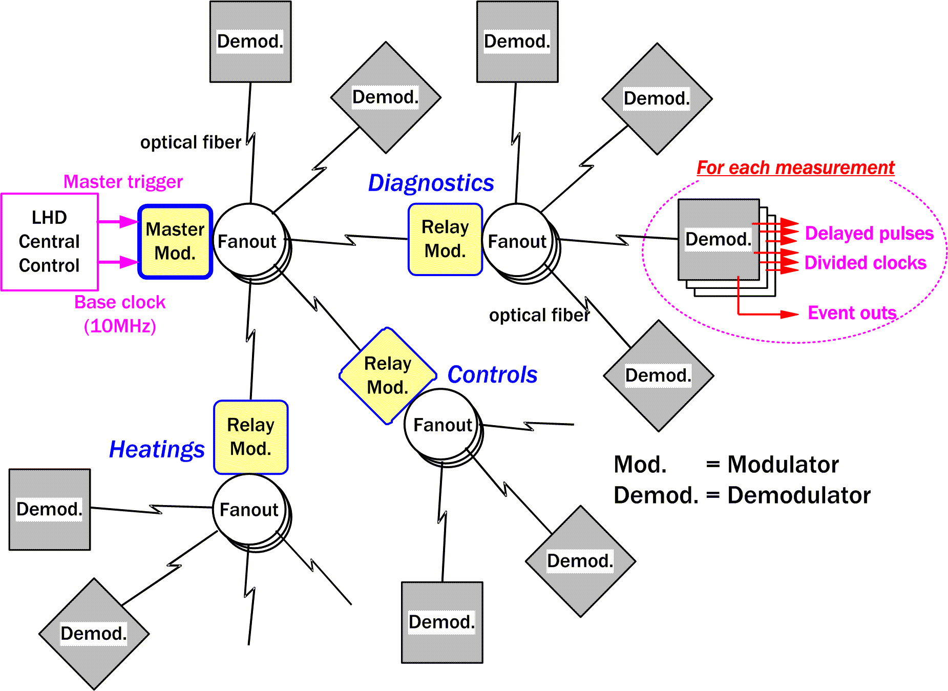
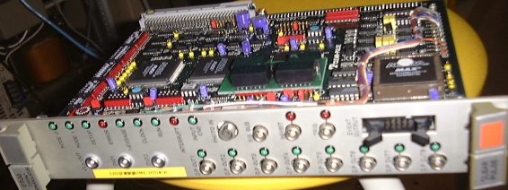
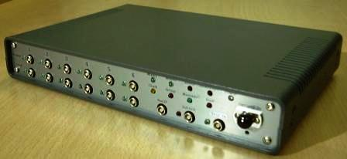
2nd control tier – LHD timing system for DAQs
Tree structured, modulator – (relay) – demodulator dedicated fiber chains
  (1st gen.) VME-based modulator (1) & demodulator (30) modules running on RTOS
  DAQ nodes (= no. of demod.) increased.
  → Aged VME modules must be replaced.
  As VME modules are expensive, hard to upgrade,
  needing OS dependent drivers,
    Low cost, down-sized, maintenance-free,
    one-chip system, i.e. “FPGA-based SoC”,
    has been developed in-house (2nd gen.)
  More than 40 FPGA demodulators are now operating.

Slide 6
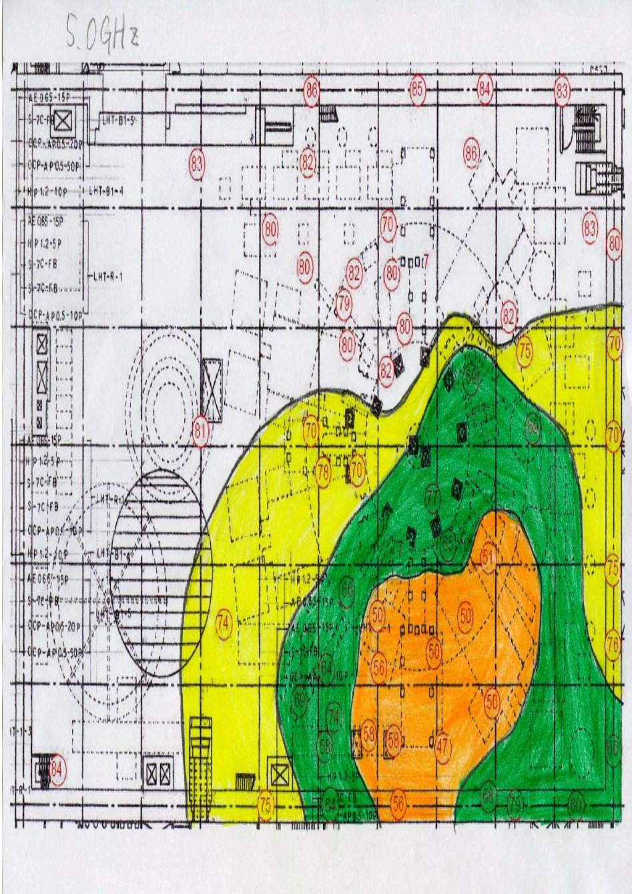
WLAN verification in torus hall
Wifi easily provides the electric isolations between devices.
Test results show that one WiFi access point is never able to cover the torus and the peripheral equipment at once.
  5 GHz WLAN hardly reach the backside of some big obstacles.
  One of two access points was affected by some discharge noises to be non-responding, which must be power recycled for recovery.
2.4 GHz
5.0 GHz
> -50 dBm
> -60 dBm
> -70 dBm
> -80 dBm

Slide 7
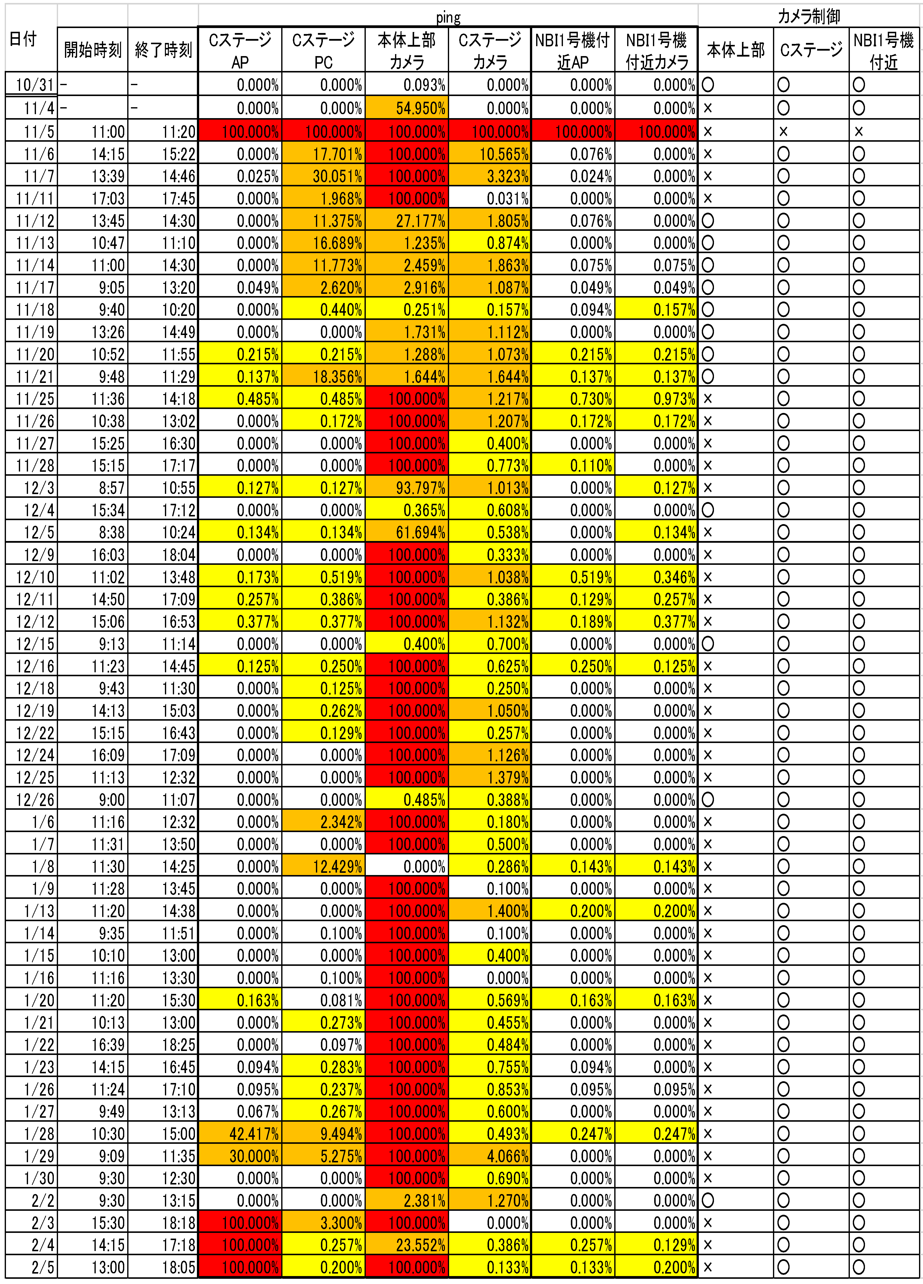
WLAN verification in torus hall (cont.)
Packet losses were apparently increased even during the H plasma discharge.
  A camera on the torus has no response
  mostly during the plasma discharge (red).
  Some PCs and devices had > 1 %
  packet loss (orange color) .
  Others often indicate some significant errors even < 1 %(yellow color).
WLAN are not enough reliable especially for D-D experiments generating higher radiation field.

Slide 8
Control levels on device control & data network
The following commanding levels can be defined.
Operation-level:
  Real-time monitor for device status & progress of processes
  Interactive change of operation parameters, modes, etc.
  Details of errors & warnings must be easily checked.
Application/OS-level:
  Start/stop/restart the application processes
  Kill abnormal or zombie processes
  User interactive recovery if possible (by shell command)
Device-level:
  Power on/off/recycle the device
  For PCs, remote KVM (console) would be more favorable.
In any case, commanding to a single device individually or to all the devices at once should be selectable.

Slide 9
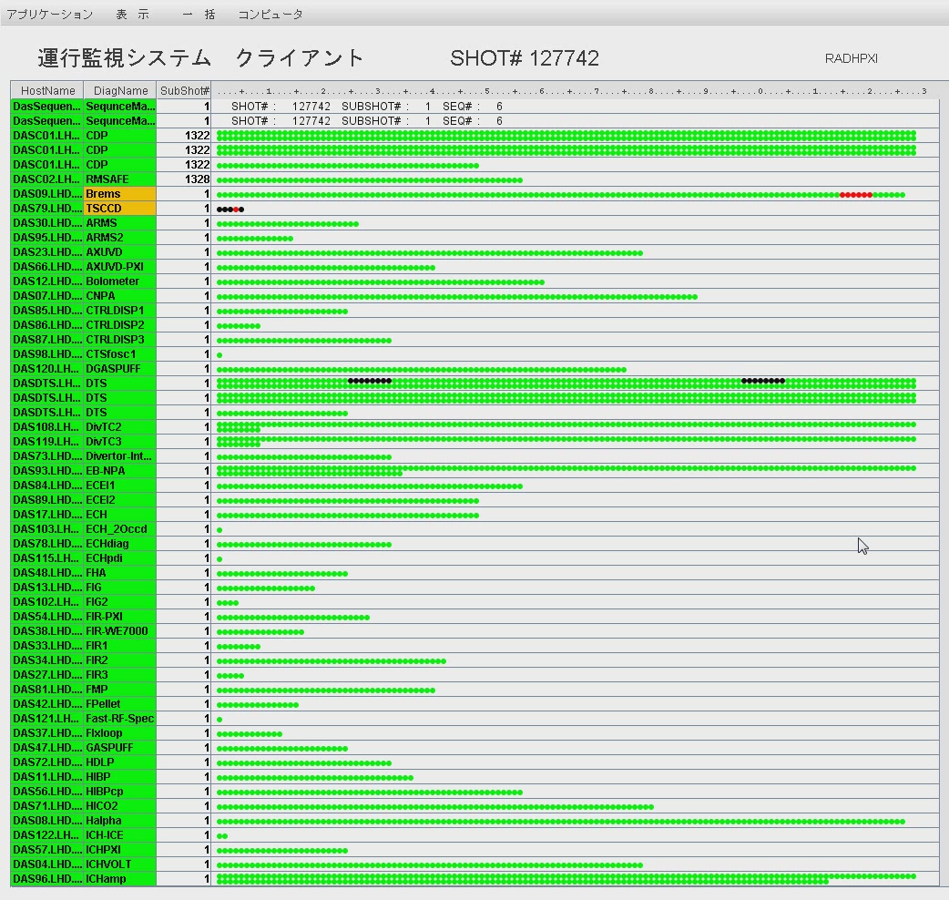
Integrated manager console for DAQs (movie)

Slide 10
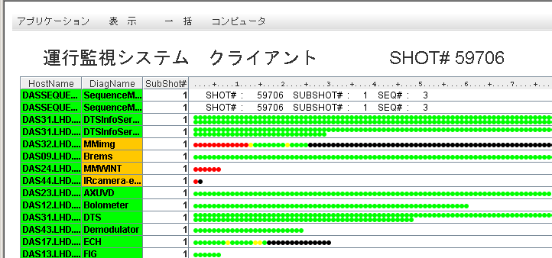
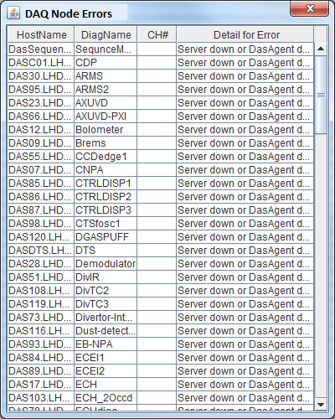
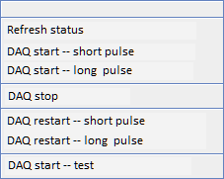
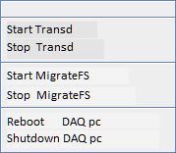
Integrated manager console (cont.)
Application
Sort
Command
Server
DAQ Process Monitor & Manager
Popup Error Dialog
DAQ process commanding
DAQ host ope.

Slide 11
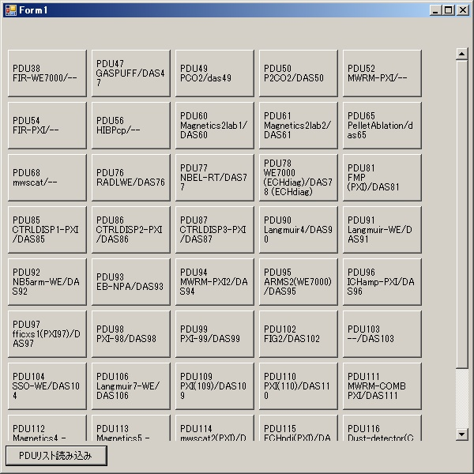
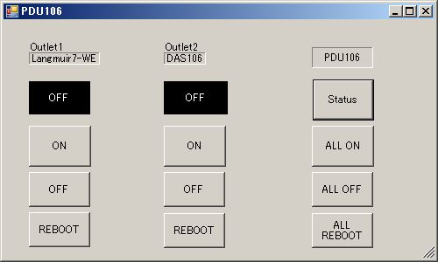
PDU manager GUI
Remote on/off control of power distribution is necessary in high dose D-D experiments.
  Software-based reset will be inoperable to frozen-up devices.
  >100 device control requires a central management GUI.
  Device-level ope. GUI should be separated from app./ope. one.

Slide 12
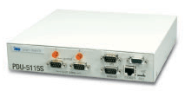
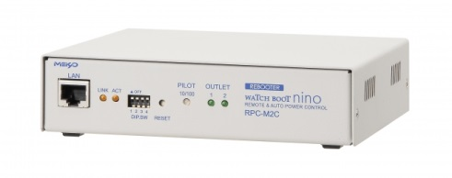
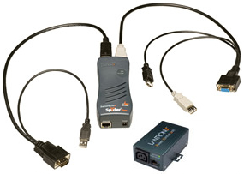
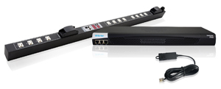
PDU products
The following commercial PDU products have been tested and selected for every user case in LHD.
  ISA PDU-5115S, 15 Ax2, rsh/snmp
  Meikyo WATCH BOOT nino (RPC-2LC),
  max.15 A (x2), telnet/web/snmp
  Lantronix Spider Duo (w/ remote KVM),
  10 Ax1, telnet/ssh/web
  Raritan PX2-5472JV-A1,
  max.20A (x24), telnet/ssh/web/snmp
The central manager GUI covers the variation
of products and their protocols.

Slide 13
Summary
LHD is preparing for high radiation D-D experiments.
  Not only process monitoring/commanding but also power on/off control have been enabled for remote controllability.
  The integrated manager has been completed with GUI.
  PDU control is separated from the process operation GUI, considering the device safety against human mistakes.
During the plasma campaign, WiFi connections have been examined in the LHD torus hall.
  It revealed that usual WiFi is not enough reliable for using in fusion plasma experiments.
Timing distribution unit has been upgraded
  to be maintenance-free, down-sized, easy-upgradable, low cost, FPGA-based SoC.

Slide 14
Abstract
The LHD is planning to start D-D experiments in the late 2015 Japanese fiscal year. After the beginning of D-D experiments, the opportunity for the maintenance works inside the torus room will be conspicuously reduced so that all the intelligent instruments must be remotely controlled.
The LHD data acquisition (DAQ) and archiving system have been using about 110 DAQ frontend [1]. For their central management, a real-time DAQ progress monitoring system has been implemented, where the operator can remotely command every DAQ node separately or wholly at once [2].
Every DAQ frontend consists of modular digitizers, backplane chassis, and a DAQ computer sometimes with an optical interface and peripheral devices. However, these electronics are well known to suffer the “single-event effect (SEE)” from the D-D neutrons. In that case, the software-based remote operation might become ineffective to reset the nonresponding fault device. Therefore, it is indispensable to be able to securely intercept or recycle the electric power of the device for recovering from the D-D peculiar malfunctions, such as the SEE failures.
In this study, a centralized control and monitor function has been developed for the number of power distribution units (PDUs) installed for every DAQ node. The central management system of the DAQ computers has been based on the “multi-agent” model, and thus, the communication protocol between them has been unified. However, it is difficult to unify the protocol for multi-vendor’s commercial PDU products. Therefore, the central PDU management system has adopted the plugin structure in which the plugin modules can absorb the differences between the products.
Another device control network is the LHD timing distribution system which adopts the tree-structured dedicated fiber links from the master modulator to the terminal demodulators [3]. Not only the synchronized operation but also the standalone operation is possible for local dry runs or calibration tests with the homemade “sequence emulator” commanding.
The combination of above mentioned functionalities has realized the flexible and highly reliable remote control infrastructure for the plasma diagnostics and the device management in LHD.

